Slide 1
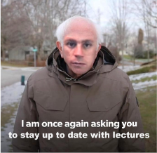
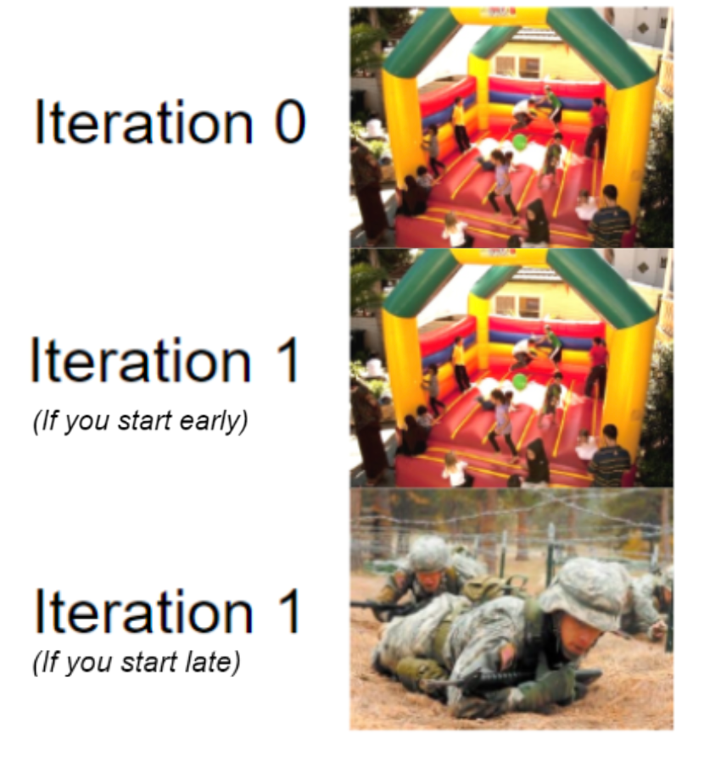
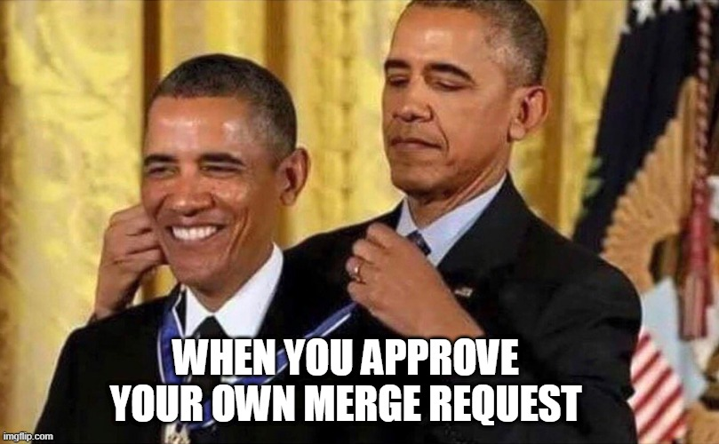
COMP1531 | T09B / H17B
Week 3
william.huynh3@unsw.edu.au

Slide 2
Learning objectives
Tips for Iteration 1
Refactoring code using JS principles
Installing and using NPM packages
Using JEST to test our code

Slide 3
Iteration 1 Tasks
Major Tasks (40% weighting)
Minor Tasks (60%)
Write tests for the 11 functions
Code quality (discussed later in tute - 25%)
Implement those 11 functions
Git Practices (15%)
authLoginV1
authRegisterV1
channelsCreateV1
channelsListV1
channelsListAllV1
channelDetailsV1
channelJoinV1
channelInviteV1
channelMessagesV1
userProfileV1
clearV1
Project Team Work (15%)
Assumptions File (5%)

Slide 4
JS: Code Smells
Code smells are signs that something is wrong stylistically with your code and demands your attention.
‘Code smells’ or code quality is worth 25% of Iteration 1

Slide 5
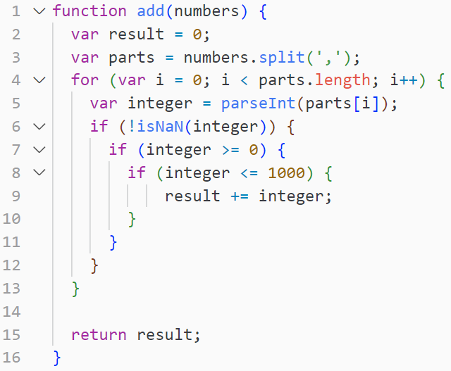
What looks immediately wrong with this code?
What could be a potential fix?

Slide 6
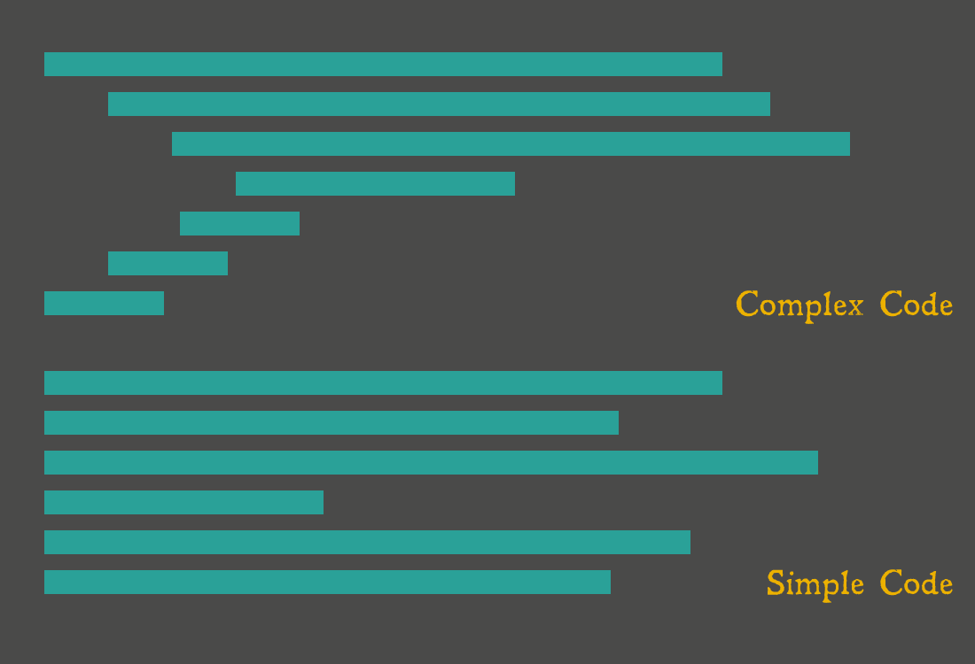
Code Smell: Excessive Indentation
Turn complex logic into functions
Avoid nested loops or nested conditions (again use functions!)
See if there are existing NPM libraries that can do complex things for you

Slide 7
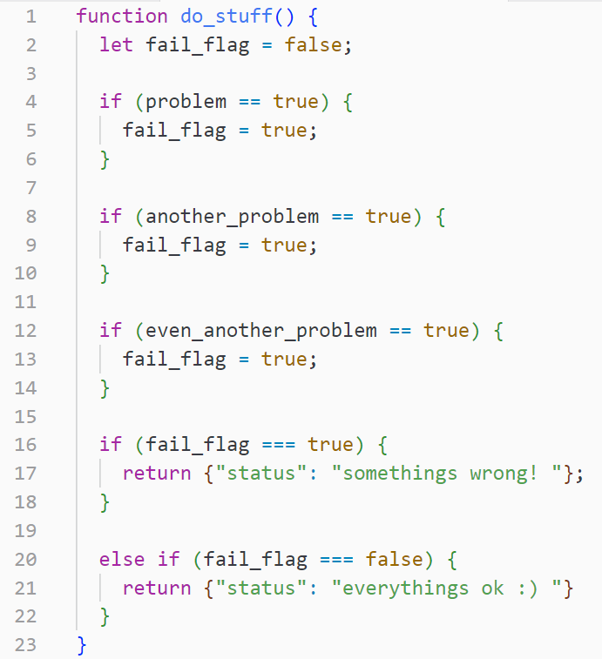
What looks immediately wrong with this code?
What could be a potential fix?

Slide 8
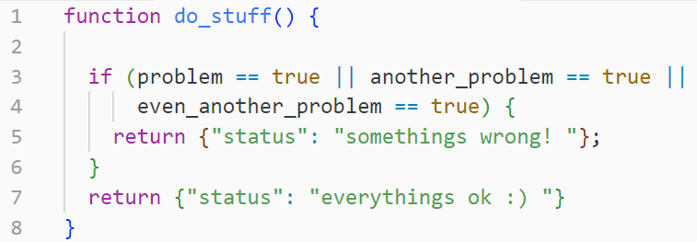
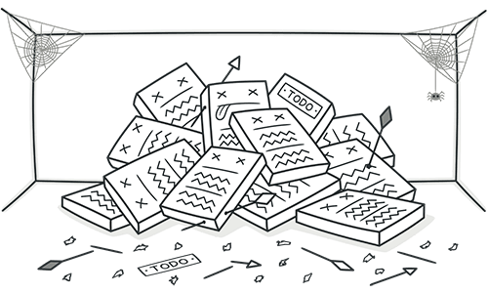
Code Smell: Unnecessary logic

Slide 9
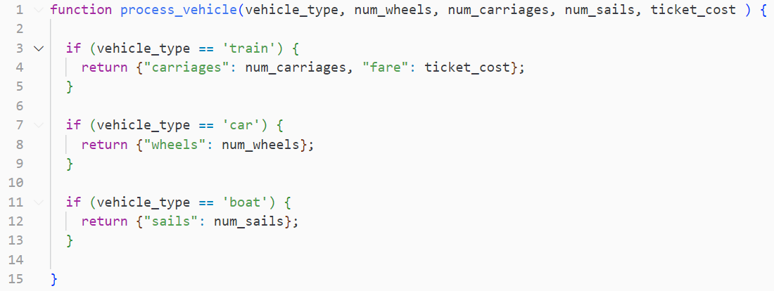
What looks immediately wrong with this code?
What could be a potential fix?

Slide 10
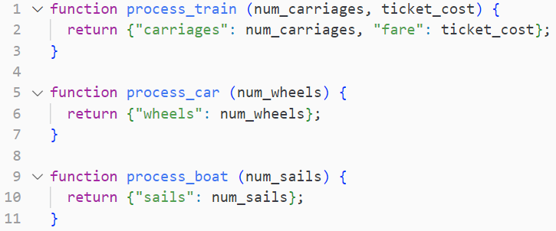
Code Smell: Too Many Parameters

Slide 11
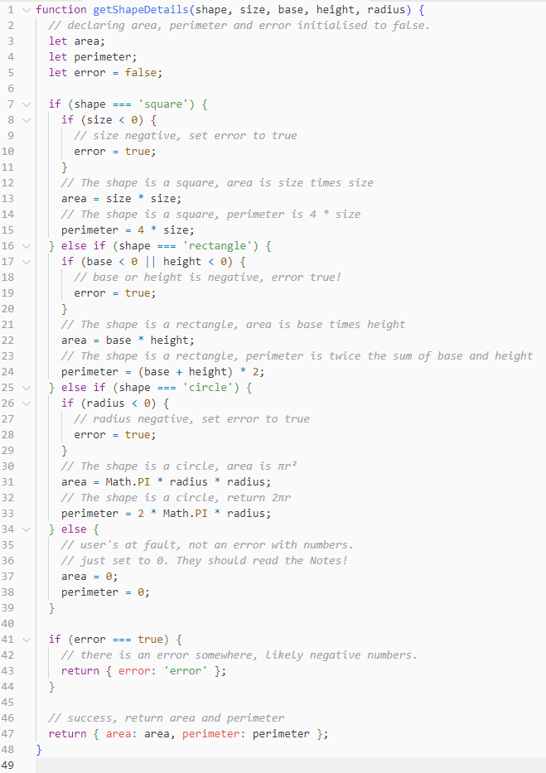
Activity
One of your team members has merged one of their functions without anyone’s approval !!!
Upon inspection, you realise their function is full of code smells, and your team feels at risk of losing the 25% style marks.
There are 20 minutes before the assignment is due.
Can you figure out all the code smells and refactor them before gitlab auto-submits your repo for marking ????
Note: The code can be found in the Tute03 Gitlab Repo (Webcms)

Slide 12
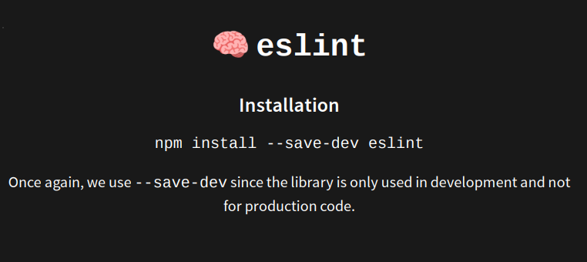
Luckily there’s an NPM library that can fix (most) code smells.
But this is not expected for iteration 1.
Source: Lectures

Slide 13
npm: Packages
Unlike C/C++, Javascript supports the importing of official and unofficial packages using npm.
This allows us to use existing, user-made functions rather than writing our own!
Whilst the use of packages is not assessed, it will save you LOTS of time.

Slide 14
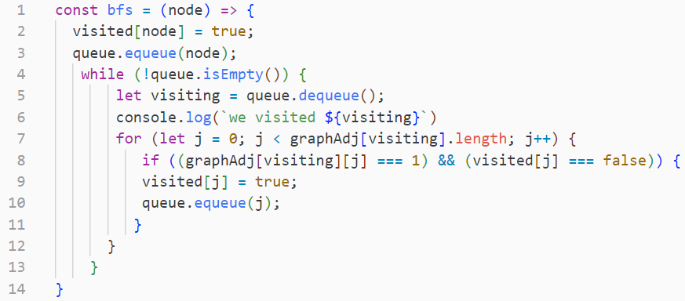

npm: using packages vs no packages
no packages
using packages

Slide 15
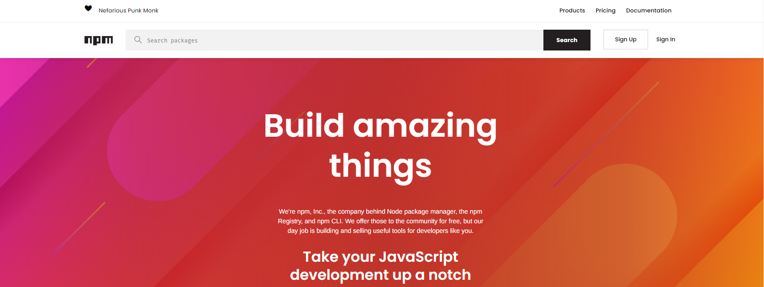
npm: Where to find packages?
npmjs.com

Slide 16
npm: How to install packages?
npmjs.com
npm install <package-name>

Slide 17
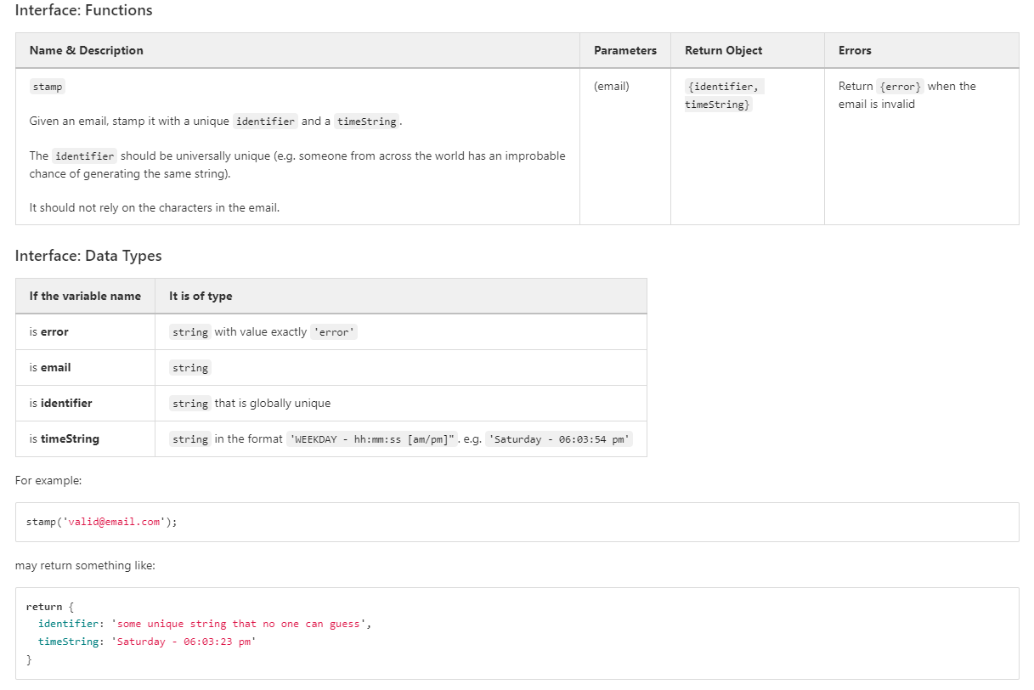
Discuss with your group the kinds of functions you'd likely need to solve this problem.
Try find some npm packages that can do it for you!

Slide 18
Email Validator
Current Date Time
Generate a UNIQUE string

Slide 19
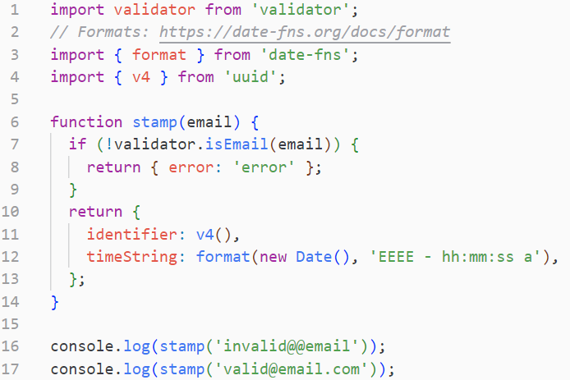
`validator` package will validate an email
`date-fns` package will create a Date() object given a date format.
`uuid` package will always generate a unique integer (id)

Slide 20
tests: JEST
When writing multi-file code for ‘big’ projects, it is crucial to test your code.
This ensures that your code is behaving as expected, and serves as a way to continually check your code is correct as you implement new functions.
In JS we use the jest library to test our code.
Writing tests using jest is worth 40% of Iteration 1

Slide 21
Setting up jest: Installing
npm install --save-dev jest @babel/preset-env

Slide 22
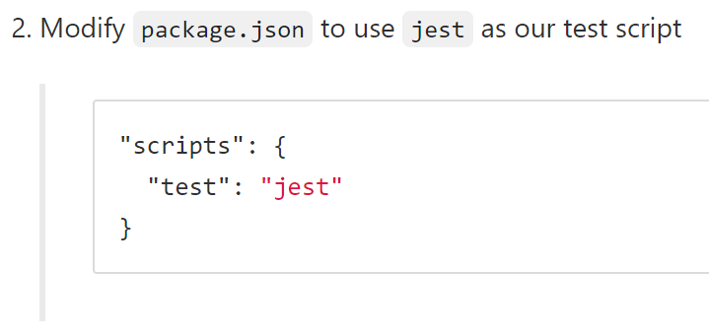
Setting up jest: Make our code use jest

Slide 23

Setting up jest: How to setup files with jest?
auth.js
auth.test.js

Slide 24
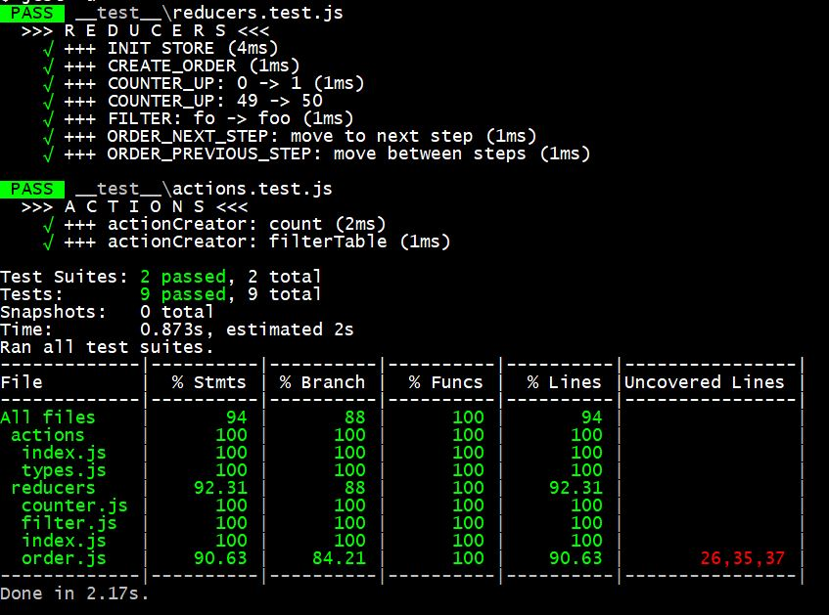
Setting up jest: Running our tests
npm run test

Slide 25
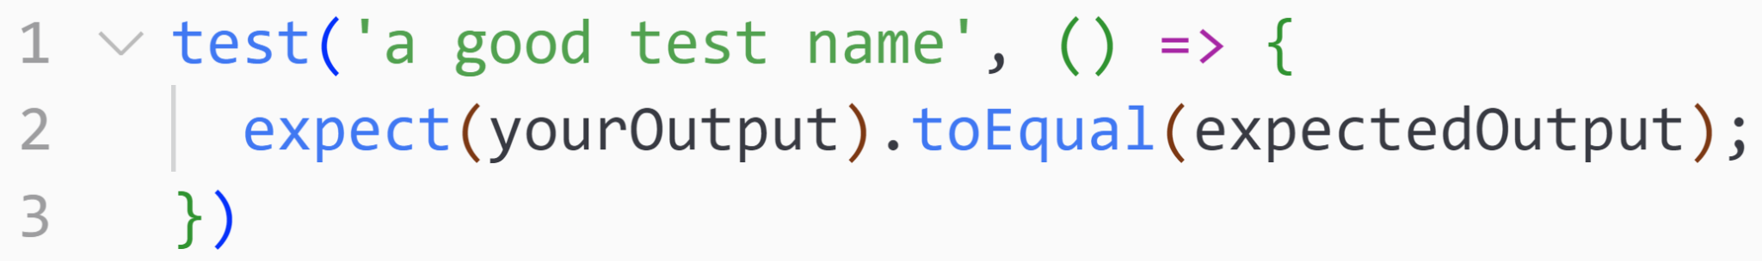
using jest: Creating a basic test
auth.test.js
test -> Initialises a test block for JEST to run
expect -> JEST function that MUST be true for the test to pass
toEqual -> compares your output with expected output

Slide 26
🏡 Teamwork Principles
Brainstorm a list of good and poor attributes for team members working on a project.
Suppose there is a member in a group who has gone silent and has yet to complete much of their assigned work. The reason is unknown.
How should the remaining members approach the situation?
What can groups do beforehand such that if this occurs, they can manage or minimise the impact?

Slide 27
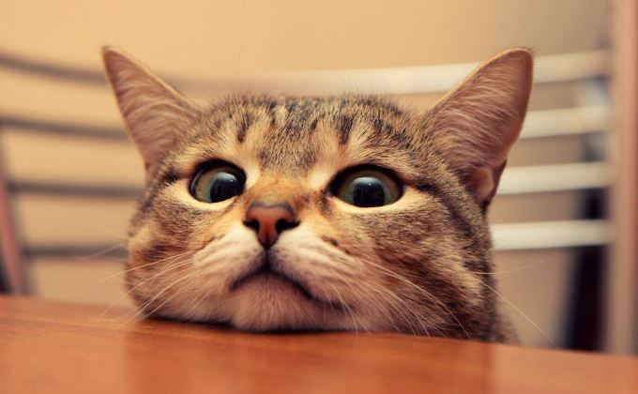
🏡 Be a good team member !!!
📢 Communication
⏰ Time Management
💕 Honesty
📋 Responsibility
✨ Enthusiasm (for your group + project!)

Slide 28
🏡 But what if…
A team member suddenly disappears without doing their work!
What should you do?
Immediately notify tutor AND allocate the work to backup group member(s)
Maintain contact with the group member (maybe a message a day)
  Please don’t be aggressive
Document it (in meeting minutes)

Slide 29
using jest: Let’s give it a spin
Setup jest in our project folder
Create a new file called sum.js
Create a new file called sum.test.js
Write some tests for a basic sum function
Implement the sum function
Run the tests

